Slide 1


Dept. of Computer Science and Engineering
Fall-2022, 221-Day, Section-DD
Subject: Data Structure lab
Presentation Topic
Online Electric Meter System
Course Teacher : Md. Parvez Hossain
Md. Sabbir Hossain
ID: 221902126

Slide 2
The project has two part
01
02
Admin portal
User portal
PROJECT GOALS
You can describe the topic of the section here

Slide 3
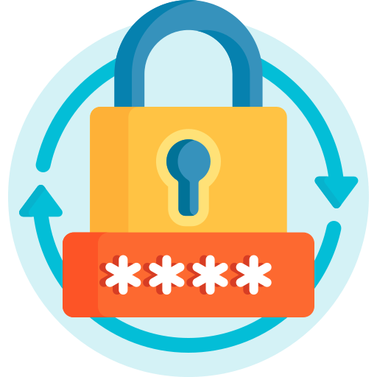
What is Password System ?
Password system is a system that facilitates a simple, secure way to store passwords and access them quickly when required.
In this project I made a strong password system that is to keep
secure Admin and User details.

Slide 4

Project developing
The project is developed by C programing Language and data structure .
C is a middle-class Language .
which were developed in 1972 by Dennis Ritchie at Bell Laboratories

Slide 5
Tools and condition
Data structure and C has many tools and condition
I used :
Tree
Linear search
Array
If –else condition
Switch
For loop
7. User define function
8. Pointer
9. Structure
10. File

Slide 6
This project has some limitation
The length of meter number do not limitation.
The length of amount number do not limitation
The date do not limit we can input any invalid date.

Slide 7
Projrct Advantage
It has many advantage :
User can see their past bill history, unit cost history
Admin can save their time and cost.
Do not waste Electricity

Slide 8
Show my project

Slide 9
Thank you all

